Slide 1
Speaker Recognition System
EEC201 FINAL PROJECT
OhCaptainMyCaptain
2025-03-19

Slide 2
CONTENTS
Slide 1: Title
Slide 2: Overview
Slide 3: Implementation Highlights
Slide 4: Key Functions & Scripts
Slide 5: Test & Results (Part 1)
Slide 6: Test & Results (Part 2)
Slide 7: Observations
Slide 8: Conclusions
Slide 9: References & Acknowledgments

Slide 3
01
Slide 1: Title

Slide 4

Slide 1: Title
Team: OhCaptainMyCaptain
Members: Zherong Yu & Haoyang Li
LI’S PART
YU’S PART

Slide 5
02
Slide 2: Overview

Slide 6
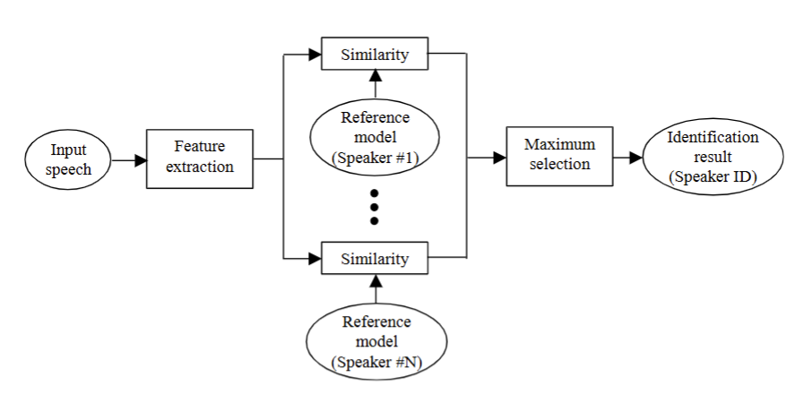
Slide 2: Overview
This diagram shows how input speech is processed to extract features (e.g., MFCC), then compared against multiple speaker reference models. Each model computes a similarity measure, and the maximum (best match) determines the speaker ID. Thus, classification is done by picking the most similar speaker model based on extracted features.

Slide 7


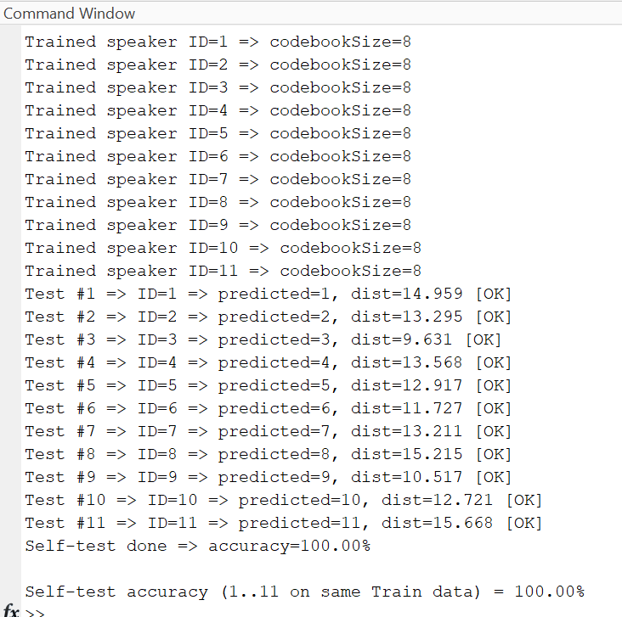
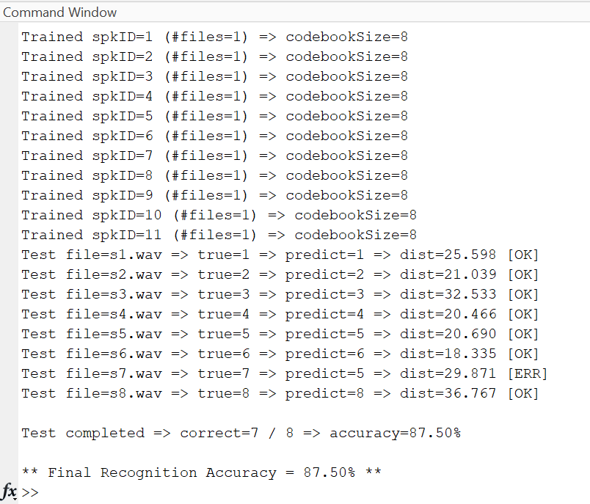


Performance:
Training accuracy up to 100%
Testing accuracy ~83%–97%

Slide 8
03
Slide 3: Implementation Highlights

Slide 9
Slide 3: Implementation Highlights
1. MFCC Extraction
- Frame, window, FFT, Mel filter bank, log + DCT
2. LBG VQ Codebooks
- Clusters MFCC vectors for each speaker
- Codebook = speaker’s centroid set
3. Notch Filter (Robustness Test)
Applies a second‐order notch filter to each test signal at given center frequency (e.g., 1000 Hz).Observes accuracy drop under this distortion, measuring system robustness.

Slide 10
04
Slide 4: Key Functions & Scripts

Slide 11
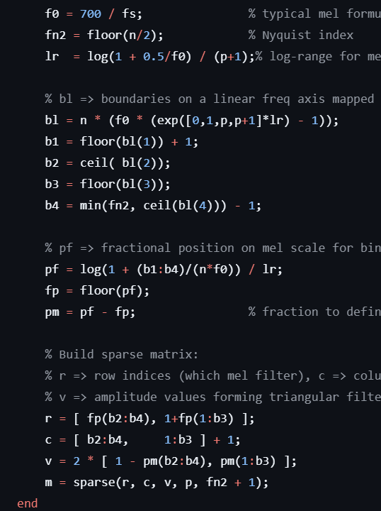
Slide 4: Key Functions & Scripts
melfb.m:
Purpose: Builds a Mel-spaced triangular filter bank.
How It Runs:
Takes number of filters p, FFT size n, and sampling rate fs.
Constructs a sparse matrix m of size (p x (n/2 +1)), where each row is one mel-scale triangular filter.
Why: This helps wrap the linear frequency axis into a mel scale, reflecting human auditory perception. It is used inside the MFCC extraction step to transform each STFT power spectrum into mel-frequency bins.

Slide 12
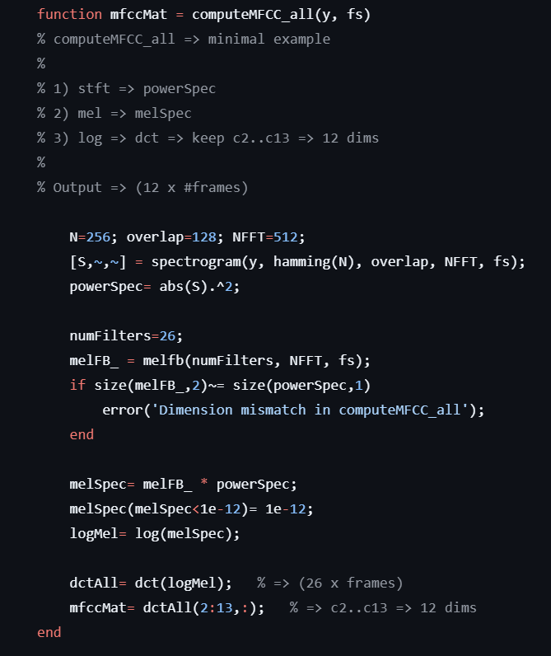
Slide 4: Key Functions & Scripts
computeMFCC_all.m:
Purpose: Converts raw audio frames into Mel-Frequency Cepstral Coefficients (MFCC).
Core Steps:
Pre-emphasis: slightly boost high frequencies by y(t) = x(t) - 0.95 * x(t-1).
STFT: short-time Fourier transform, get power spectrogram.
Mel Filter Bank (melfb): compress frequency axis.
Log + DCT: produce the final MFCC frames.
How It Connects: This function is central to extracting speaker-relevant features from each audio file before classification.

Slide 13
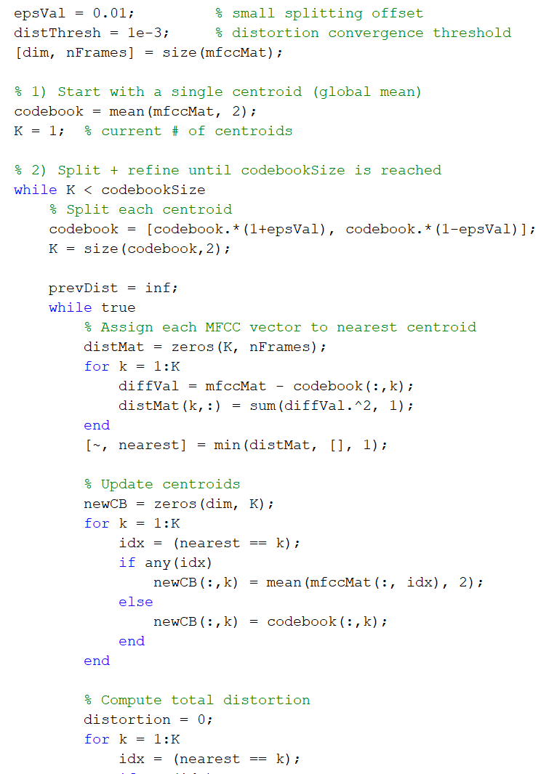
Slide 4: Key Functions & Scripts
runLBG.m:
Purpose: Creates a codebook (vector quantization) from a set of MFCC vectors.
What It Does:
Starts with a centroid (the mean of all MFCC vectors).
Splits each centroid iteratively, updates them by nearest-neighbor assignments, until reaching codebookSize codewords.
Why: We represent each word or speaker by a small set of codeword centroids. Classification then checks which codebook yields the smallest distortion to a test MFCC sample.

Slide 14
05
Slide 5: Test & Results (Part 1)

Slide 15

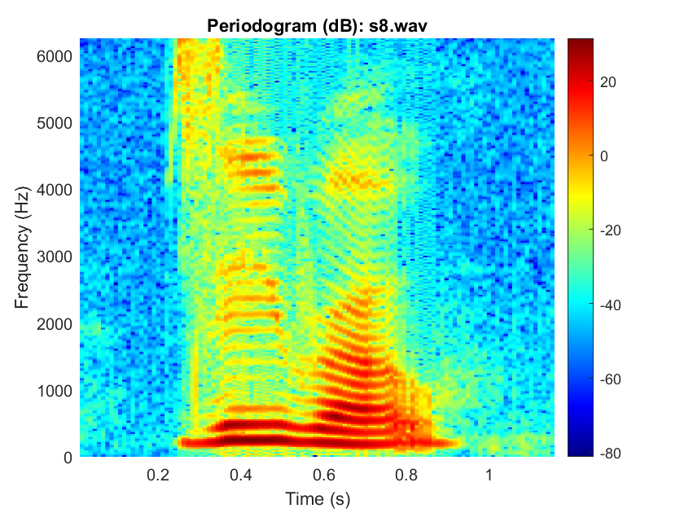
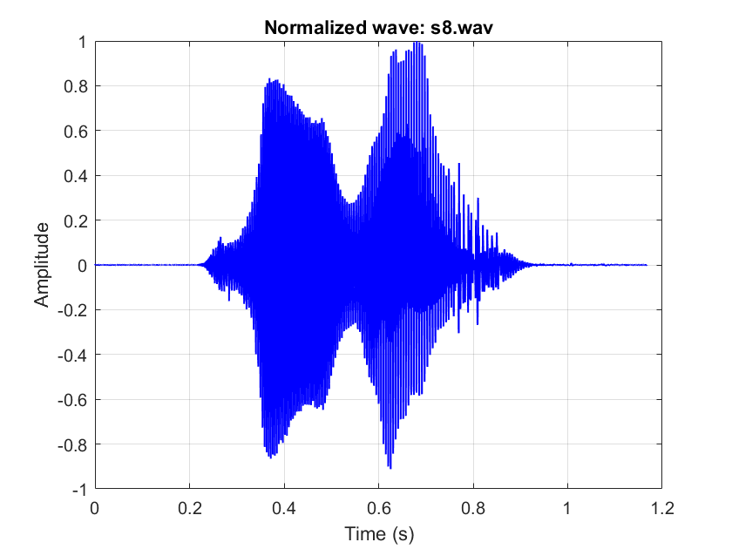
Slide 5: Test & Results (Part 1)
Test 1–4:
Test 1: Our human performance recognition rate is 72.7%.
Test 2: After the normalization of the 11 raw data from "train" folder, we plot the signal in time domain.
Use STFT to generate periodogram.

Slide 16
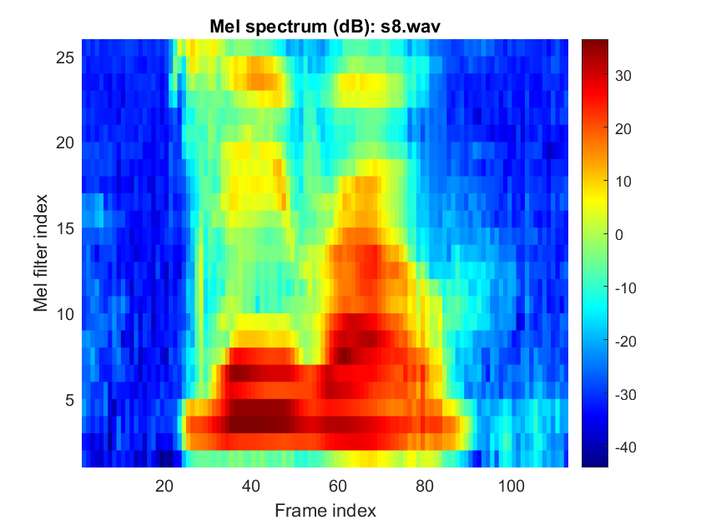
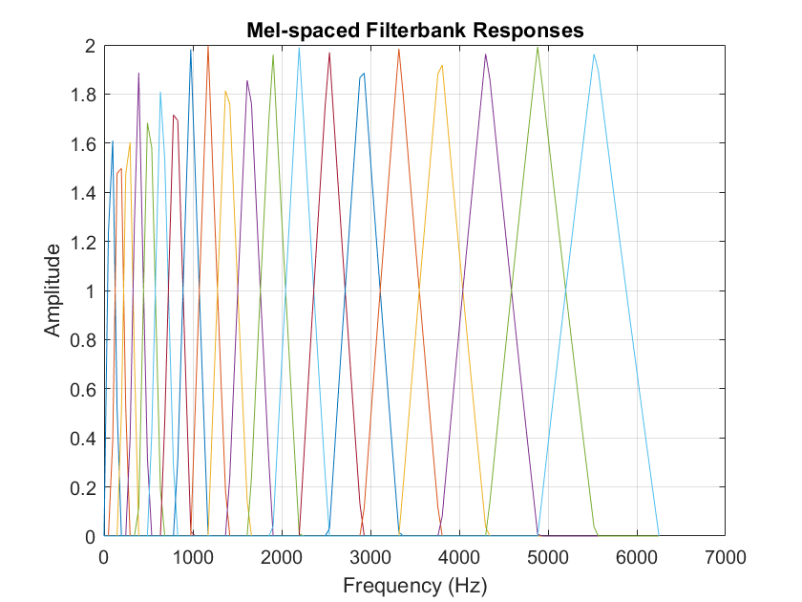
Slide 5: Test & Results (Part 1)
Test 1–4:
Test 3: Plot the mel-spaced filter bank responses. Plot the spectrum of a speech after the melfrequency wrapping step.

Slide 17
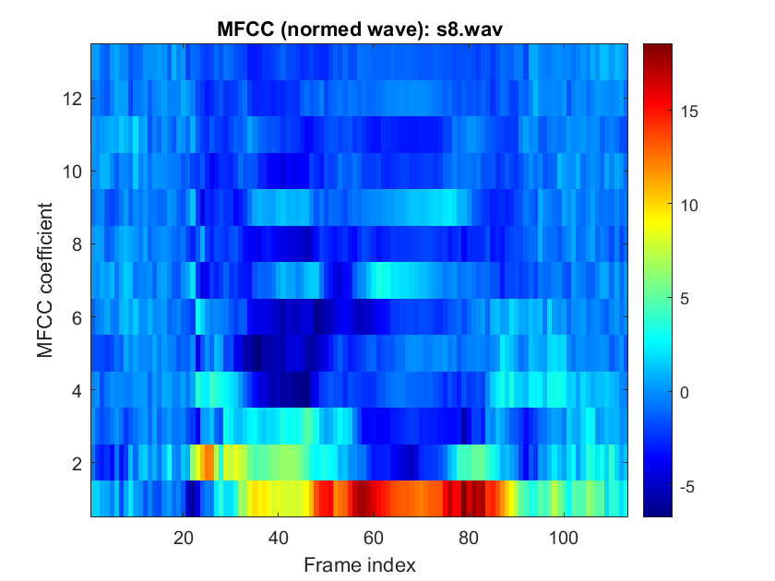
Slide 5: Test & Results (Part 1)
Test 1–4:
Test 4: Combining all steps into an MFCC extraction function.

Slide 18
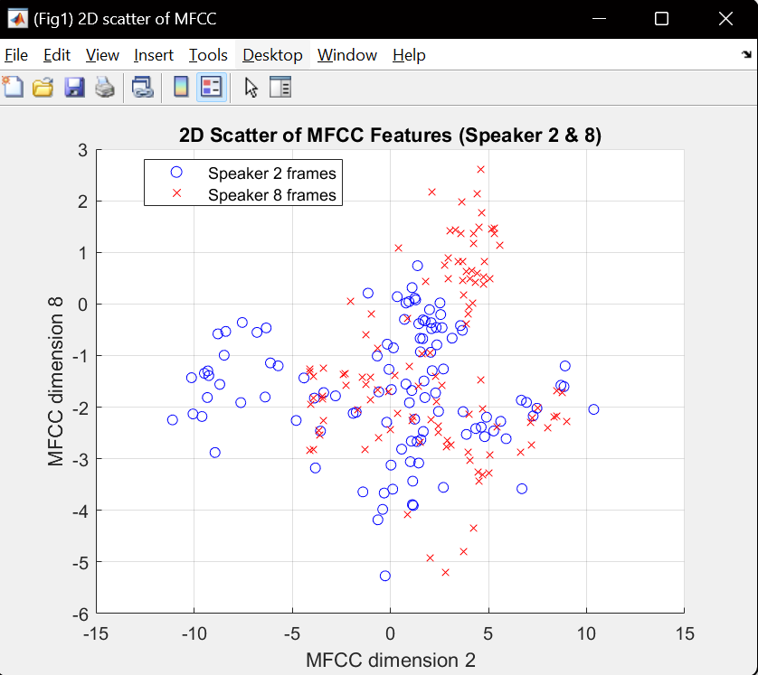
Test 5–6
Test 5: Visualizing MFCC 2D scatter for different speakers.

Slide 19
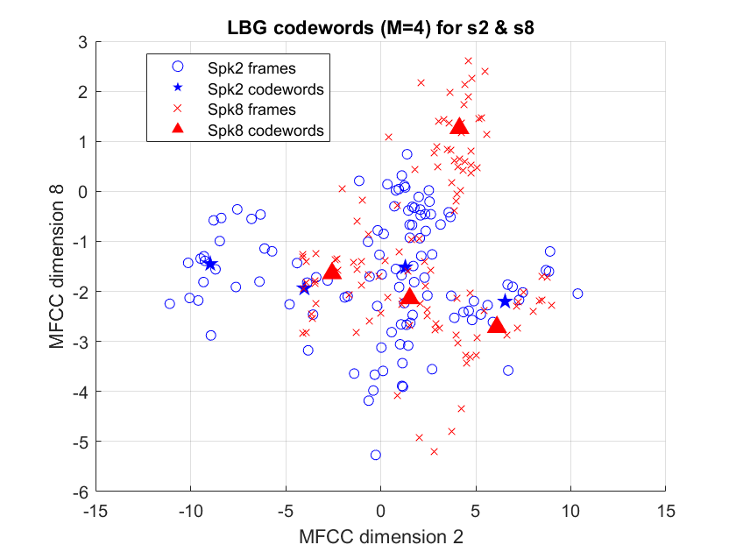
Test 5–6
Test 6: Generating LBG codewords and plotting them over the MFCC scatter.

Slide 20
06
Slide 6: Test & Results (Part 2)

Slide 21
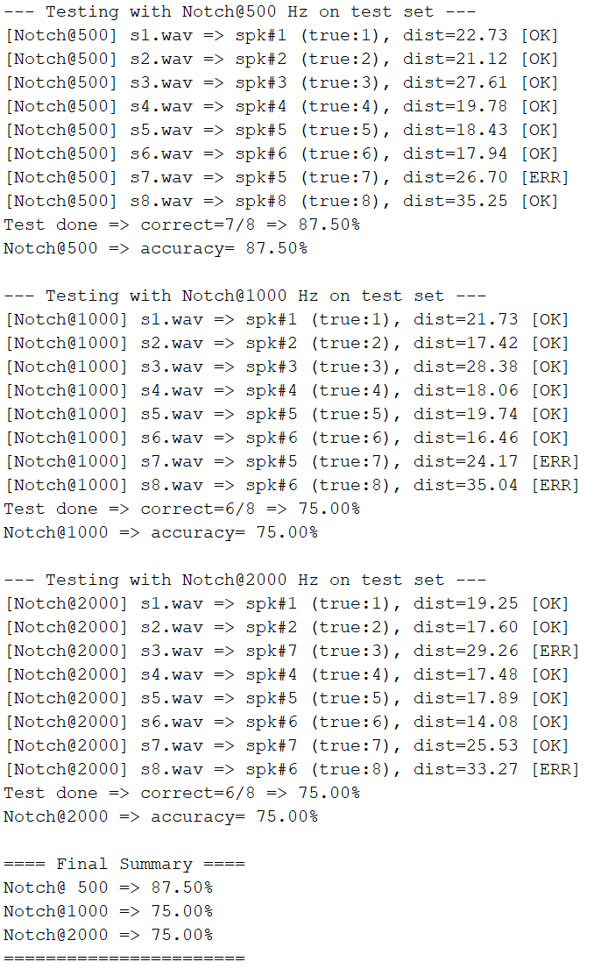

Slide 6: Test & Results (Part 2)
Test 7: ~87.5% test accuracy with standard clean data
Test 8: Applied notch filters – accuracy drops but remains viable
Test 9: Adding more speakers reduces accuracy to ~83.33%
Test 10a–10b

Slide 22
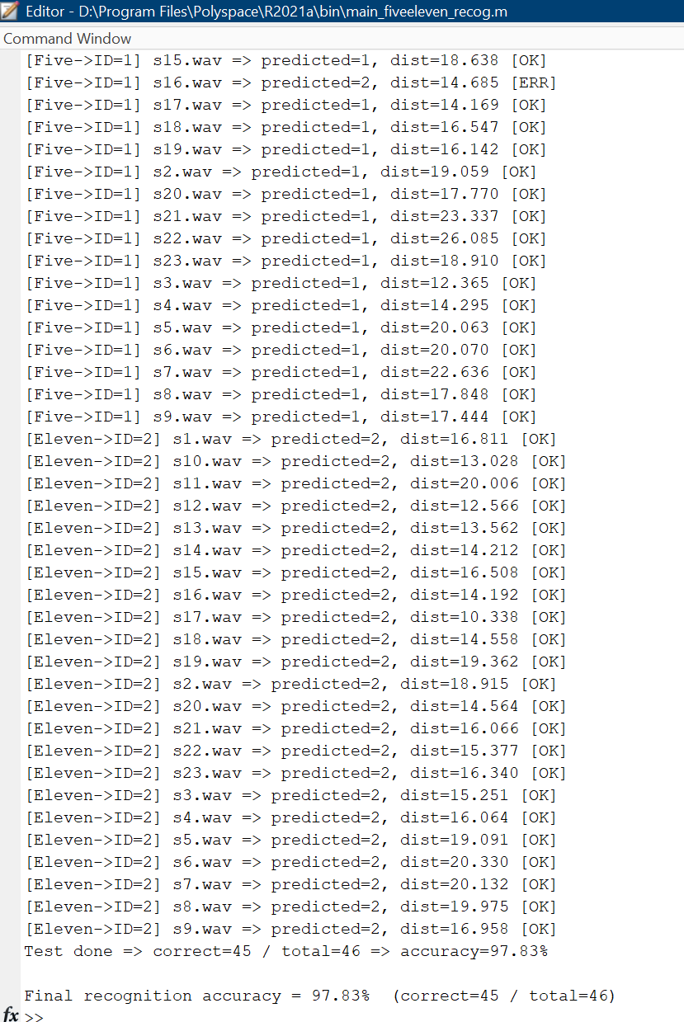
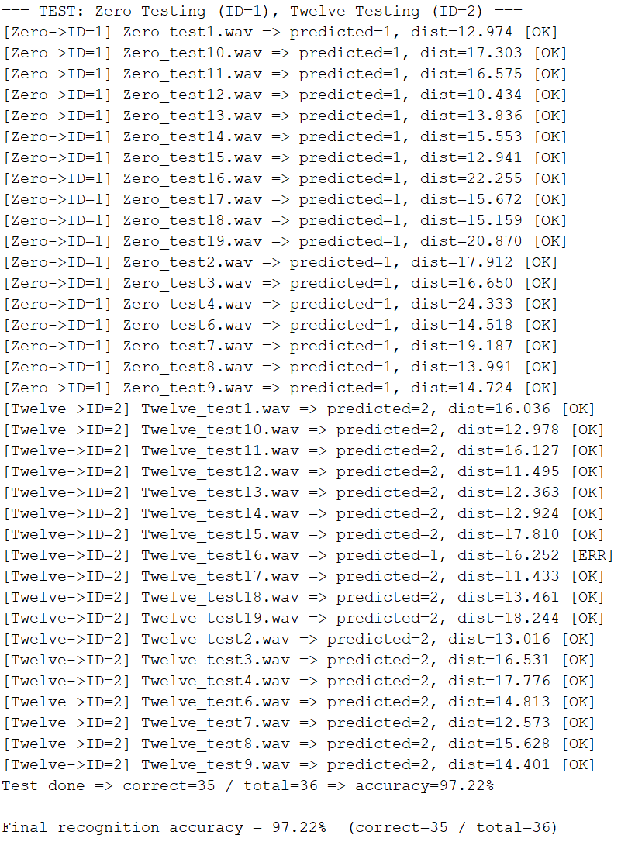

Test 10a–10b
Multi-word tasks (e.g., “zero” & “twelve,” “five” & “eleven”)
Individual word recognition up to 95–100%, combined tasks ~80–95%

Slide 23
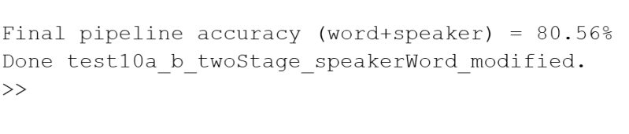
Test 10a–Q2
In Test 10a Q2, we group all speakers together with the words “zero” or “twelve” into multiple classes, with each class representing a (speaker, word) pair. We then apply LBG clustering to the MFCC vectors from the training set to generate a codebook for each class. During testing, for an unknown audio sample, we select the codebook yielding the lowest distortion; this simultaneously identifies the speaker and the spoken word.
Question 2: If we train a whole system that tries to identify
a) which speaker
b) whether the speech is "zero" or "twelve", how accurate is

Slide 24
07
Slide 7: Observations

Slide 25
Slide 7: Observations
1. High Training Accuracy: 100% indicates potential overfitting but acceptable for small sets
2. Testing: 83–97% range, influenced by noise or added speakers
3. Noise Resilience: Performance degrades with notch filters but remains functional
4. Multi-word: Slight accuracy drop when classifying both speaker & word

Slide 26
08
Slide 8: Conclusions

Slide 27
Slide 8: Conclusions
MFCC + VQ is a straightforward, effective approach for small-scale speaker recognition
Scalability: More speakers/words need more data or advanced methods
Noise & Distortions: Additional preprocessing or robust features could help
Future Work: Explore deep learning (x-vectors) or data augmentatio

Slide 28
09
Slide 9: Acknowledgments

Slide 29

Repository: 201FinalProject on GitHub
Scripts: melfb.m, computeMFCC_all.m, runLBG.m
Data: Contributed by 2024/2025 students & instructors
Thank You!

Slide 30
THE END
THANKS

